Slide 1
Resume Classification
P-287
Group -3
Notes:
This template can be used as a starter file for presenting training materials in a group setting.
Sections
Right-click on a slide to add sections. Sections can help to organize your slides or facilitate collaboration between multiple authors.
Notes
Use the Notes section for delivery notes or to provide additional details for the audience. View these notes in Presentation View during your presentation.
Keep in mind the font size (important for accessibility, visibility, videotaping, and online production)
Coordinated colors
Pay particular attention to the graphs, charts, and text boxes.
Consider that attendees will print in black and white or grayscale. Run a test print to make sure your colors work when printed in pure black and white and grayscale.
Graphics, tables, and graphs
Keep it simple: If possible, use consistent, non-distracting styles and colors.
Label all graphs and tables.

Slide 2

Business Objective
The document classification solution should significantly reduce the manual human effort in the HRM. It should achieve a higher level of accuracy and automation with minimal human intervention.
Notes:
Give a brief overview of the presentation. Describe the major focus of the presentation and why it is important.
Introduce each of the major topics.
To provide a road map for the audience, you can repeat this Overview slide throughout the presentation, highlighting the particular topic you will discuss next.

Slide 3

Project Timeline
Milestone | Date
Business Objective Discussion | 31-08-2023
Dataset Details | 01-09-2023
Exploratory data analysis | 07-09-2023
Model Building, Model Evaluation | 13-09-2023
Deployment | 20-09-2023
Presentation | 27-09-2023
Notes:
This is another option for an Overview slides using transitions.

Slide 4
Project Workflow
Business Objective
Exploratory Data Analysis
Model Building
Model Evaluation
Deployment
Data Collection
Data Preparation

Slide 5
Data Collection
The first step is to collect a dataset of resumes. Resume files can be of any format like
PDF (.pdf)
Old Word Document(.doc)
Word Document (.docx)

Slide 6
Data Preparation
Converted .pdf and .doc files into .docx files.
Used textract module to extract the text from documents.
Saved the file name, category and text into dataframe.

Slide 7
Exploratory Data Analysis
Data Preprocessing including removal of spaces, special characters, stop words etc.
Data Visualization : Bigrams, Trigrams, Word Cloud, Category wise pie chart.
Removed file_path column.

Slide 8
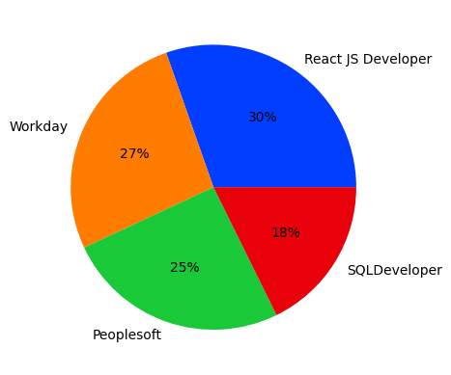
Category wise Resumes in dataset

Slide 9
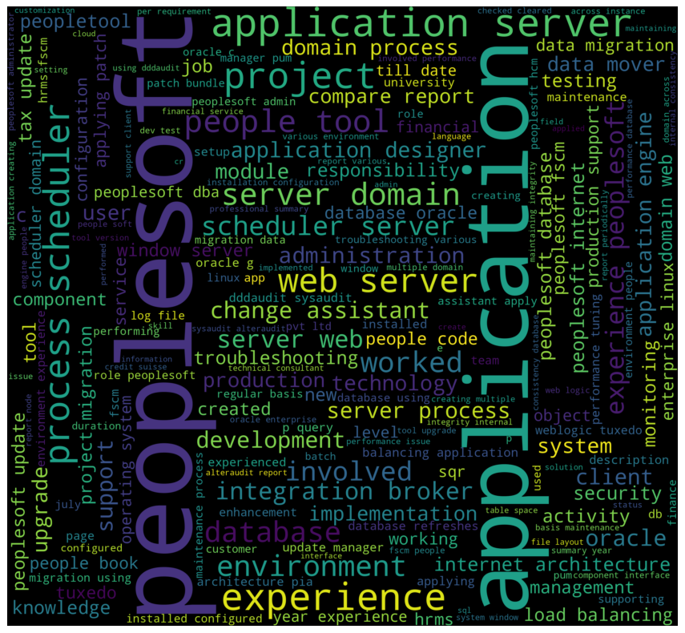
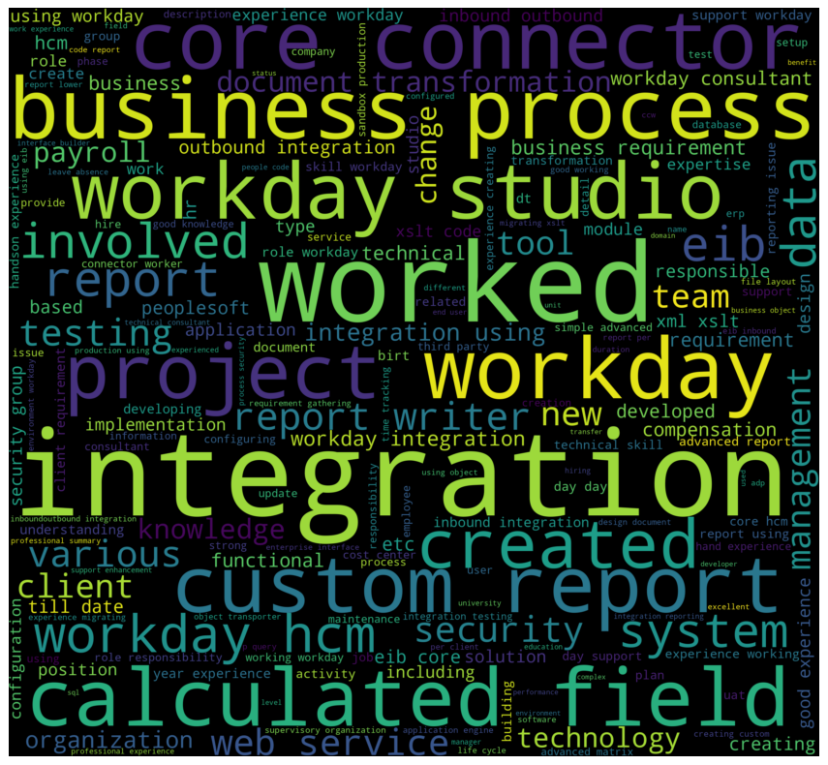
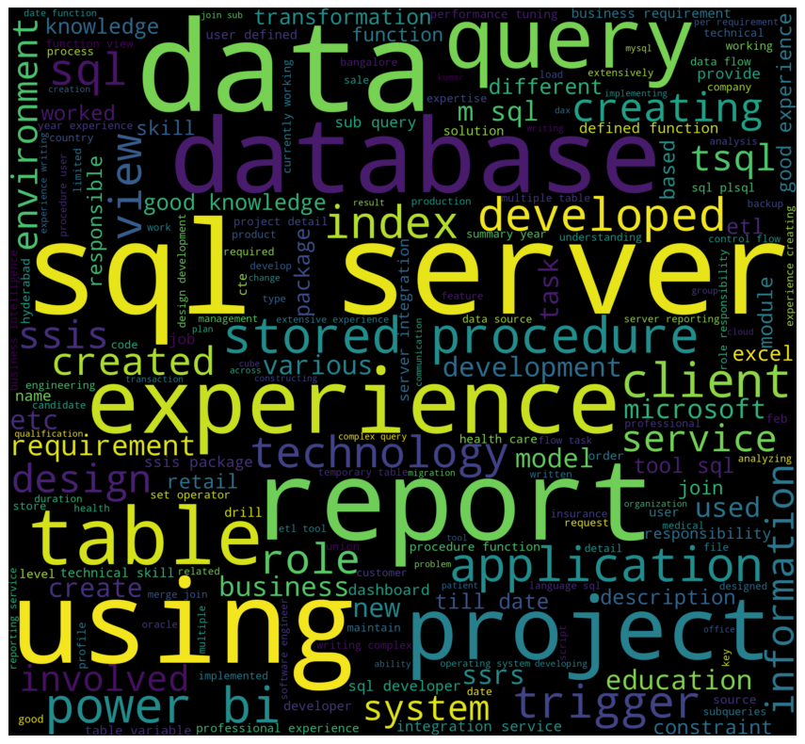
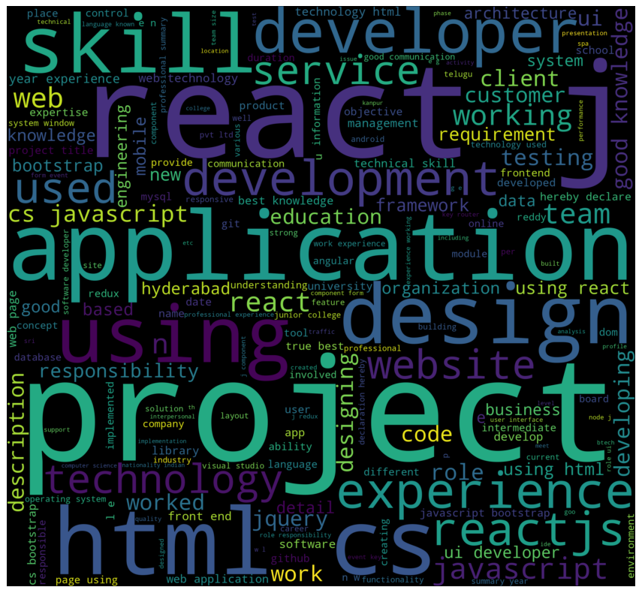
Word Clouds
Word Clouds

Slide 10
Model Building
Notes:
Use a section header for each of the topics, so there is a clear transition to the audience.

Slide 11
Models
Logistics Regression
Naive Bayes Algorithm
K-Nearest Neighbors Classification
Support Vector Machine
Decision Tree
Random Forest
XGBoost Classification
Notes:
Add slides to each topic section as necessary, including slides with tables, graphs, and images.
See next section for sample table, graph, image, and video layouts.

Slide 12
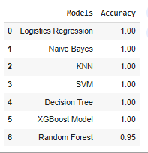
Accuracy Table

Slide 13
Final Model : XGBoost
XGBoost, short for eXtreme Gradient Boosting, is an ensemble machine learning technique that combines multiple weak predictive models, called decision trees, to create a stronger and more accurate model. It iteratively trains these decision trees by focusing on the errors made by the previous trees in the sequence, effectively minimizing the residual errors.

Slide 14
Advantages over other models:
Exceptional Performance
Handling Sparse Data and Missing Values
Regularization
Parallel and Distributed Computing
Flexibility and Customization

Slide 15
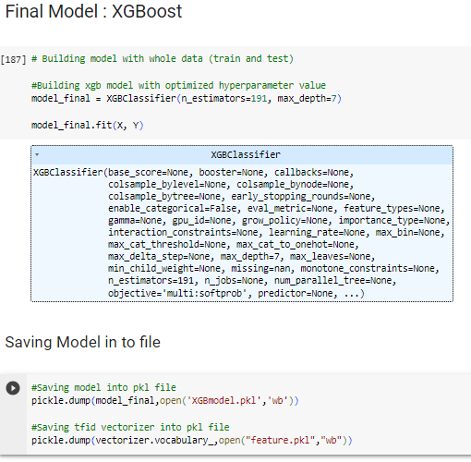
XGBoost Model
Trained the model with whole data
Saved the model in Pickle file.
Saved the TfidVectorizer

Slide 16
Deployment
Notes:
Use a section header for each of the topics, so there is a clear transition to the audience.

Slide 17
Deployment
Created .py file in Spyder for deployment.
Loaded model and Vectorizer from pickle file.
Streamlit Library for UI elements.
file_uploader object to upload resume.
Displayed predicted Category.

Slide 18
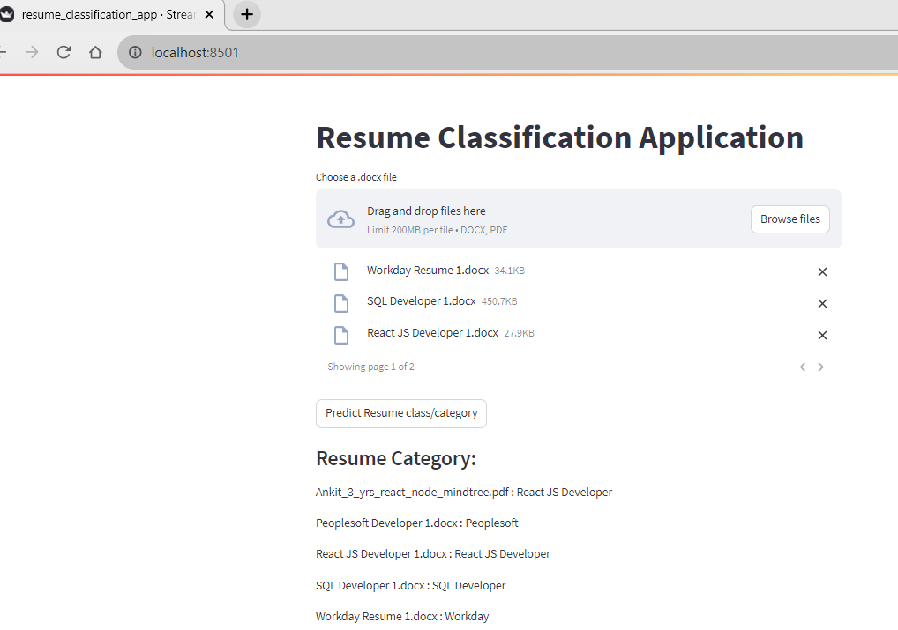

Slide 19
Thank You
Notes:
Is your presentation as crisp as possible? Consider moving extra content to the appendix.
Use appendix slides to store content that you might want to refer to during the Question slide or that may be useful for attendees to investigate deeper in the future.

